Slide 1
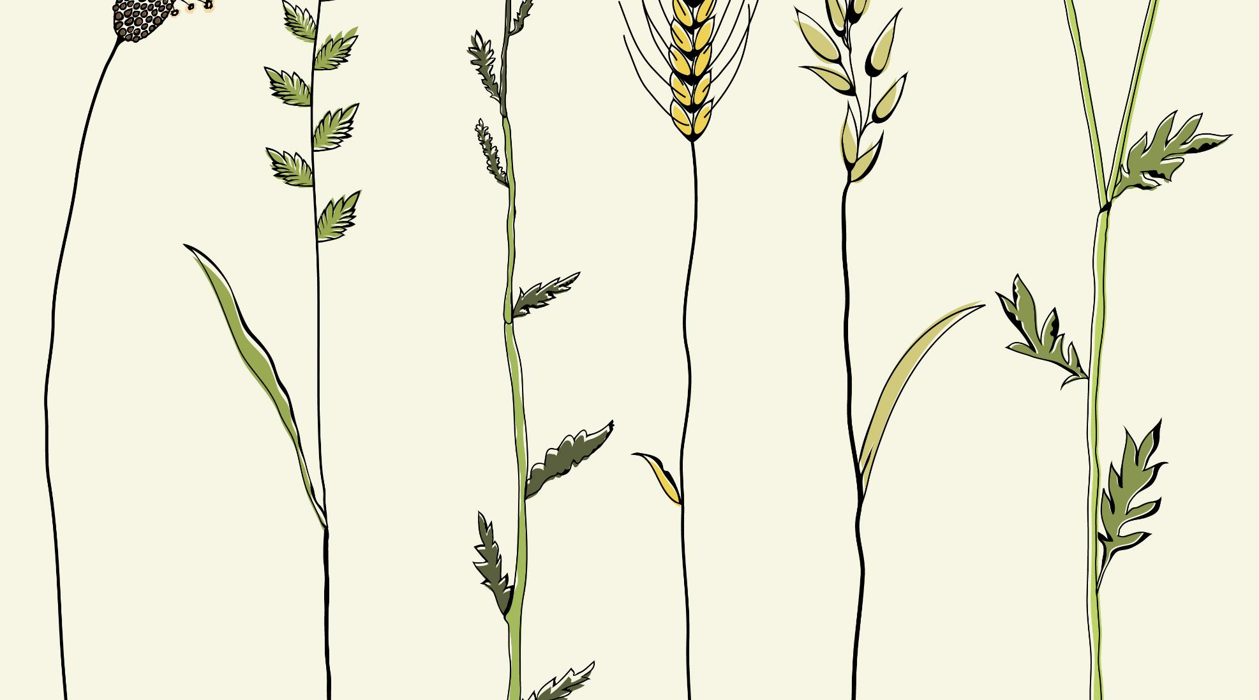
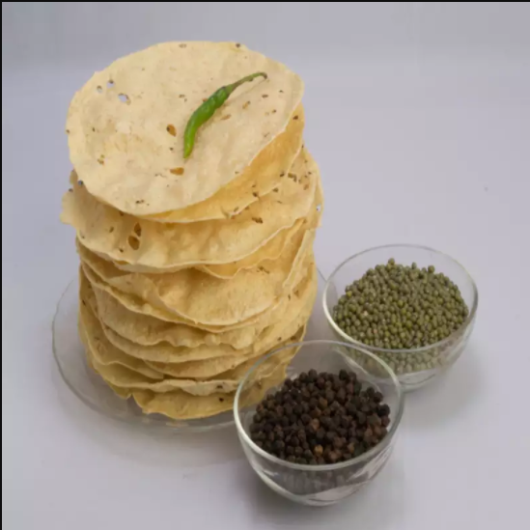
PRAKASH PAPAD
MAHARASHTRIN GAVARAN TADKA
CONTACT NUMBER: 8888197142

Slide 2
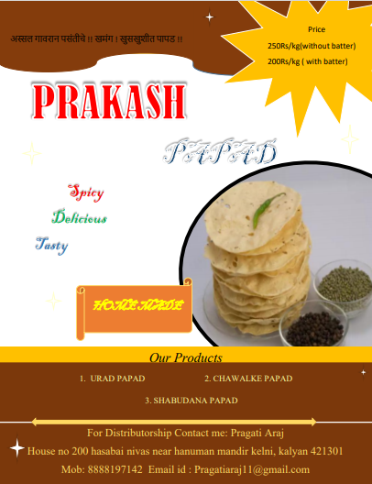
GAVARAN TADKA
This papad is traditionally spicy. It is a hand-rolled papad Made with the help of oil. It is hygienically prepared with a mix of pure stored pulses and mixed with ingredients like oil, black cumin, asafetida, mace, nutmeg, black pepper and other spices.

Slide 3
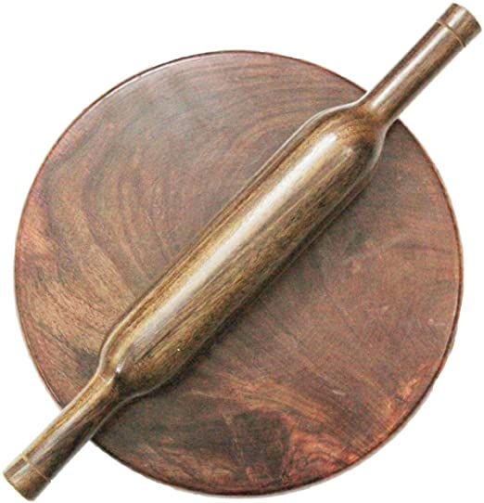

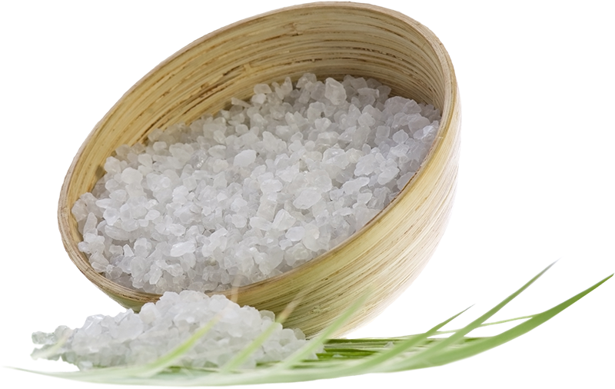
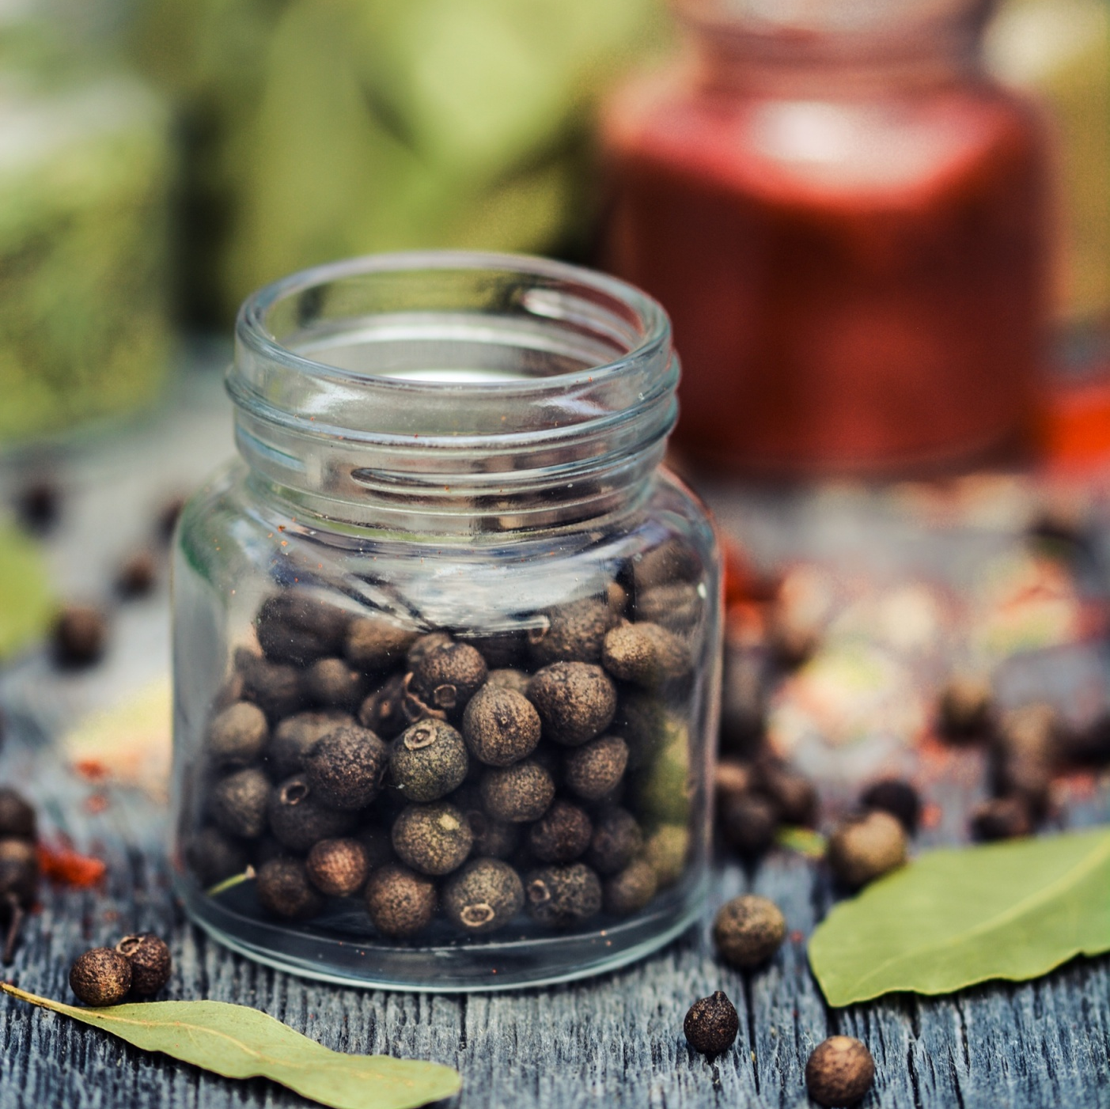

SPECIALITY
HAND
ROLLED
PURE RO
WATER
ACTIVATED
SALT
SPECIAL
SPICES
HOME
MADE

Slide 4
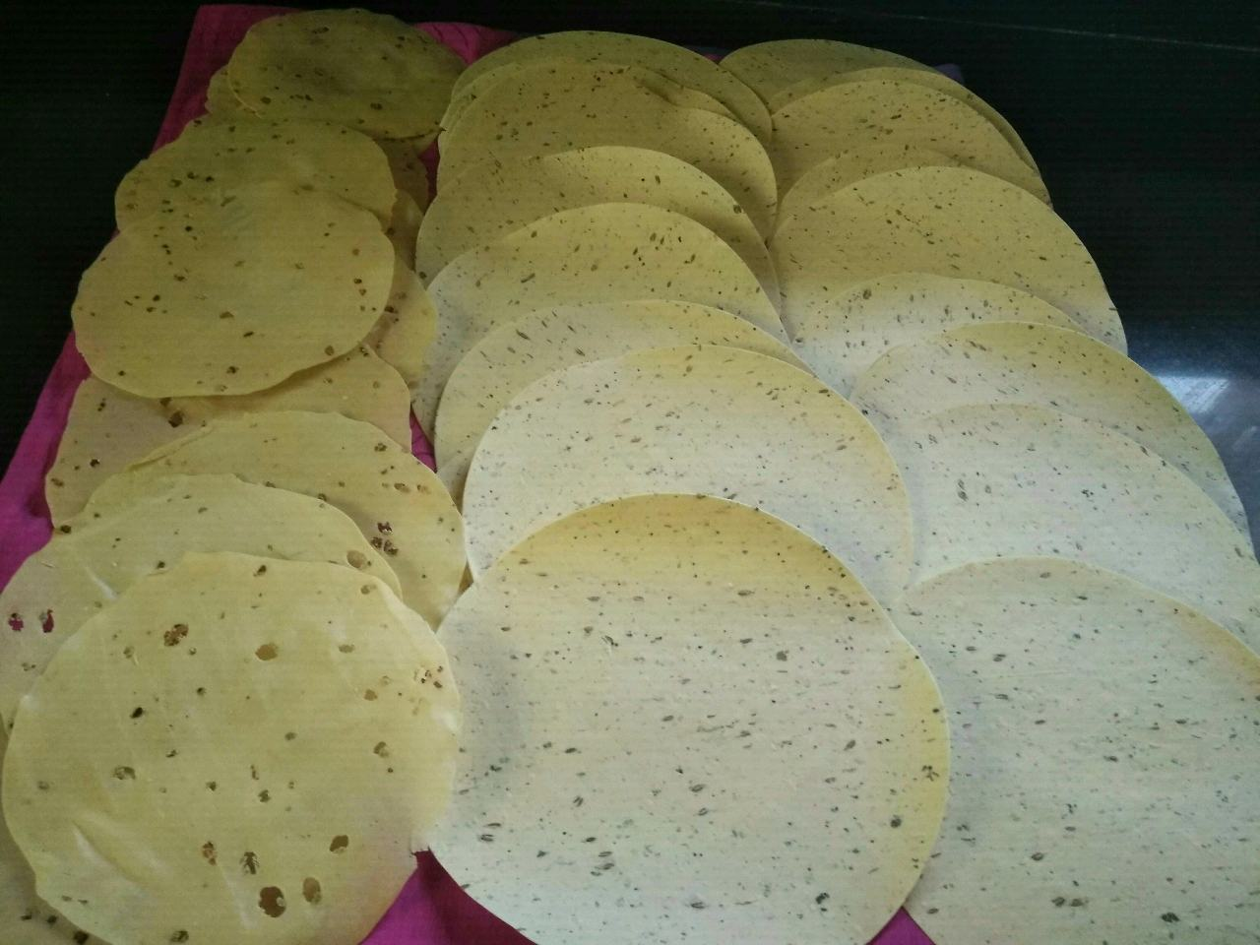
Our Product
1.URAD PAPAD:
Ingredients: Urad dal, Papad khar, Salt, Black pepper, vegetable oil, special spies.
Price:
1) 250 Rs/kg (if you don’t have dal for papad)
2) 160 Rs/kg ( if you have dal for papad)
Dal grinding price: 10 Rs/kg

Slide 5
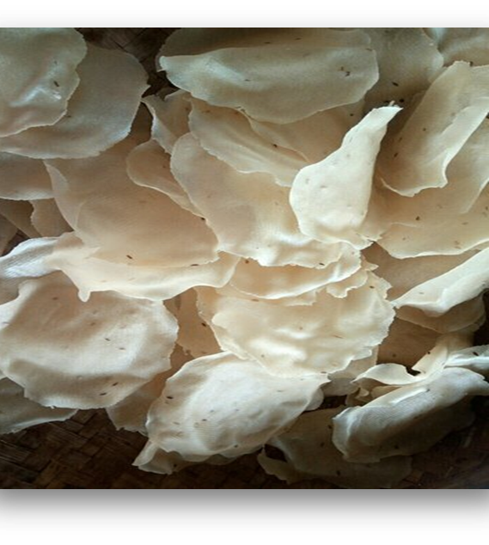
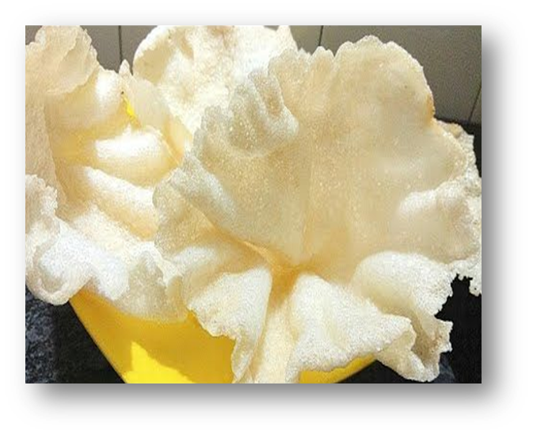
2.CHAWALKE PAPAD:
Ingredients: Chawal, Papad khar, Salt, vegetable oil
Spices as per your requirement: cumin, black pepper, shabudane
Color as per your requirements
Price:
1) 250 Rs/kg (if you don’t have chawal for papad)
2) 200 Rs/kg ( if you have Chawal for papad)
Chawal grinding price: 8 Rs/kg

Slide 6
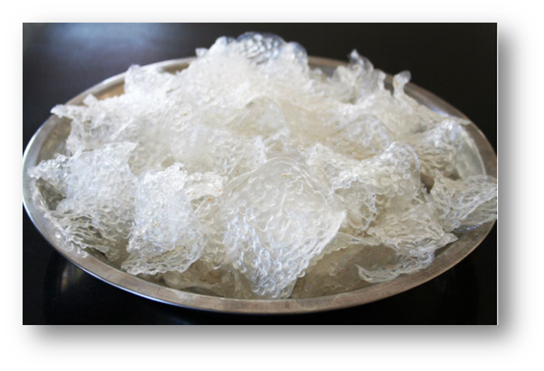
3.SHABUDANA PAPAD:
•Ingredients: Shabudane, khanacha soda, Salt, Sugar
•Color as per your requirements
•Price:
1) 250 Rs/kg (if you don’t have shabudane for papad)
2) 200 Rs/kg ( if you have shabudane for papad)

Slide 7
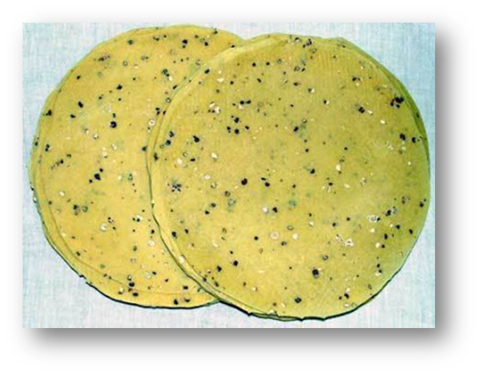
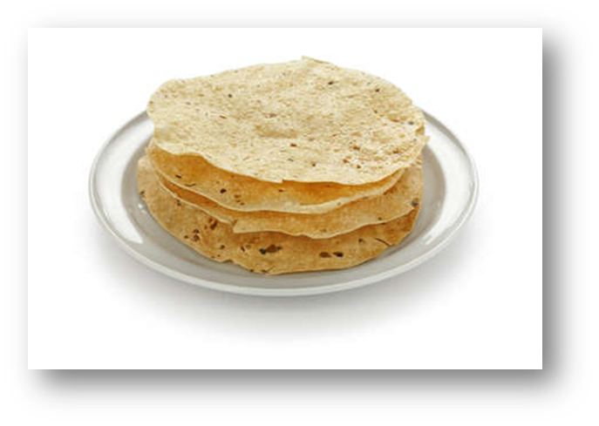
4.MOONG PAPAD:
•Ingredients: Mug dal, Papad khar, Salt, Black pepper, vegetable oil, special spies.
•Price:
1) 250 Rs/kg (if you don’t have dal for papad)
2) 180 Rs/kg ( if you have dal for papad)
•Dal grinding price: 10 Rs/kg

Slide 8
SERVICE:
GRANDING
DELIVERY
RUTURE POLICY
GRINDING SERVICE AVAILABLE( CHAKKI MACHIE)
FREE HOME DELIVERY
AND
CASH ON DELIVERY
IF YOU GOT DAMAGE PRODUCT EASY TO RETURE

Slide 9
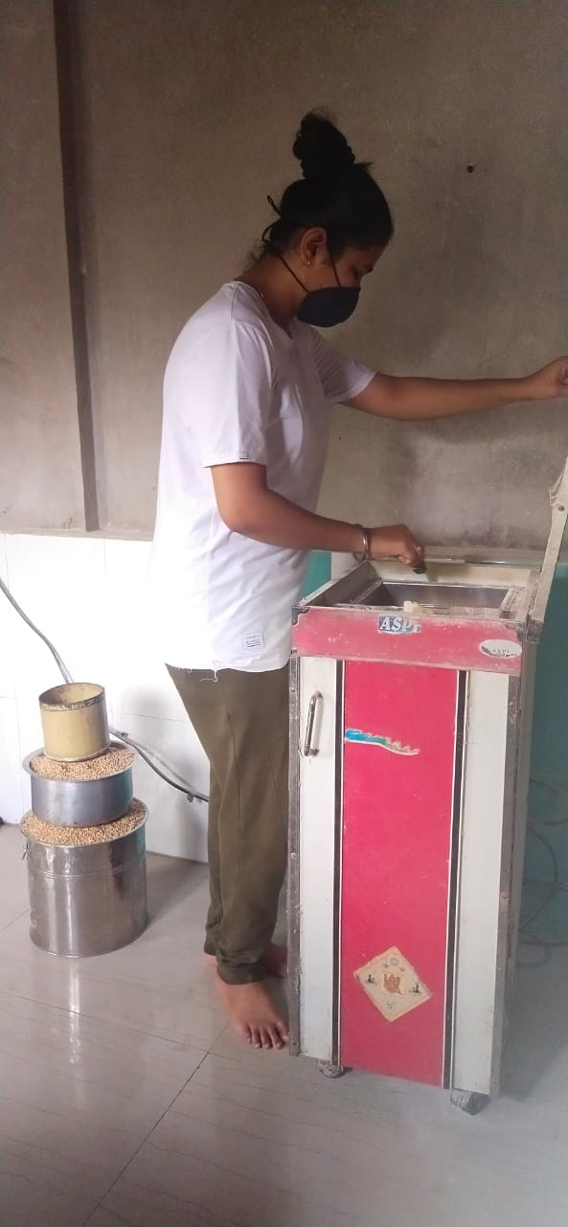
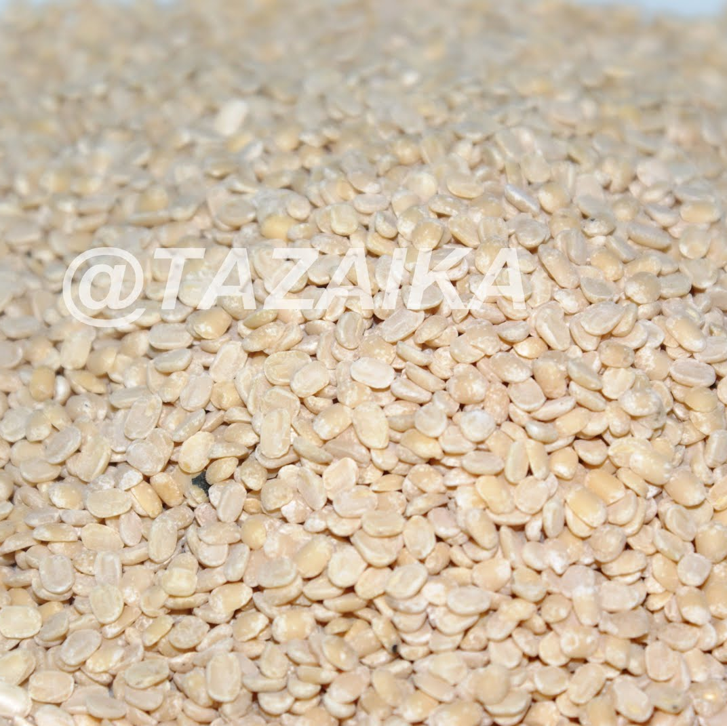
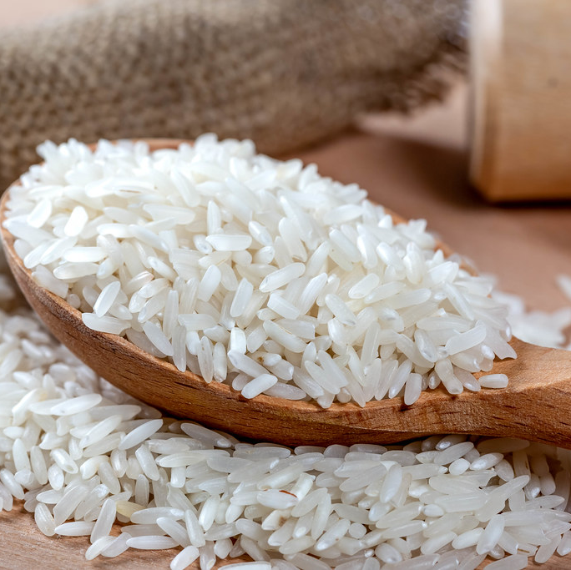
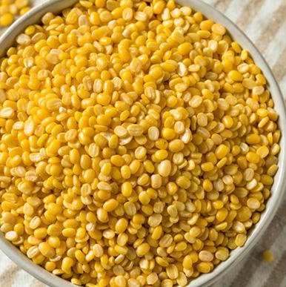
GRINDING SERVICE
1.URAD DAL:
Dal grinding price: 10 Rs/kg
2.CHAWAL
Chawal grinding price: 8 Rs/kg
3.MOONG DAL:
Dal grinding price: 10 Rs/kg

Slide 10
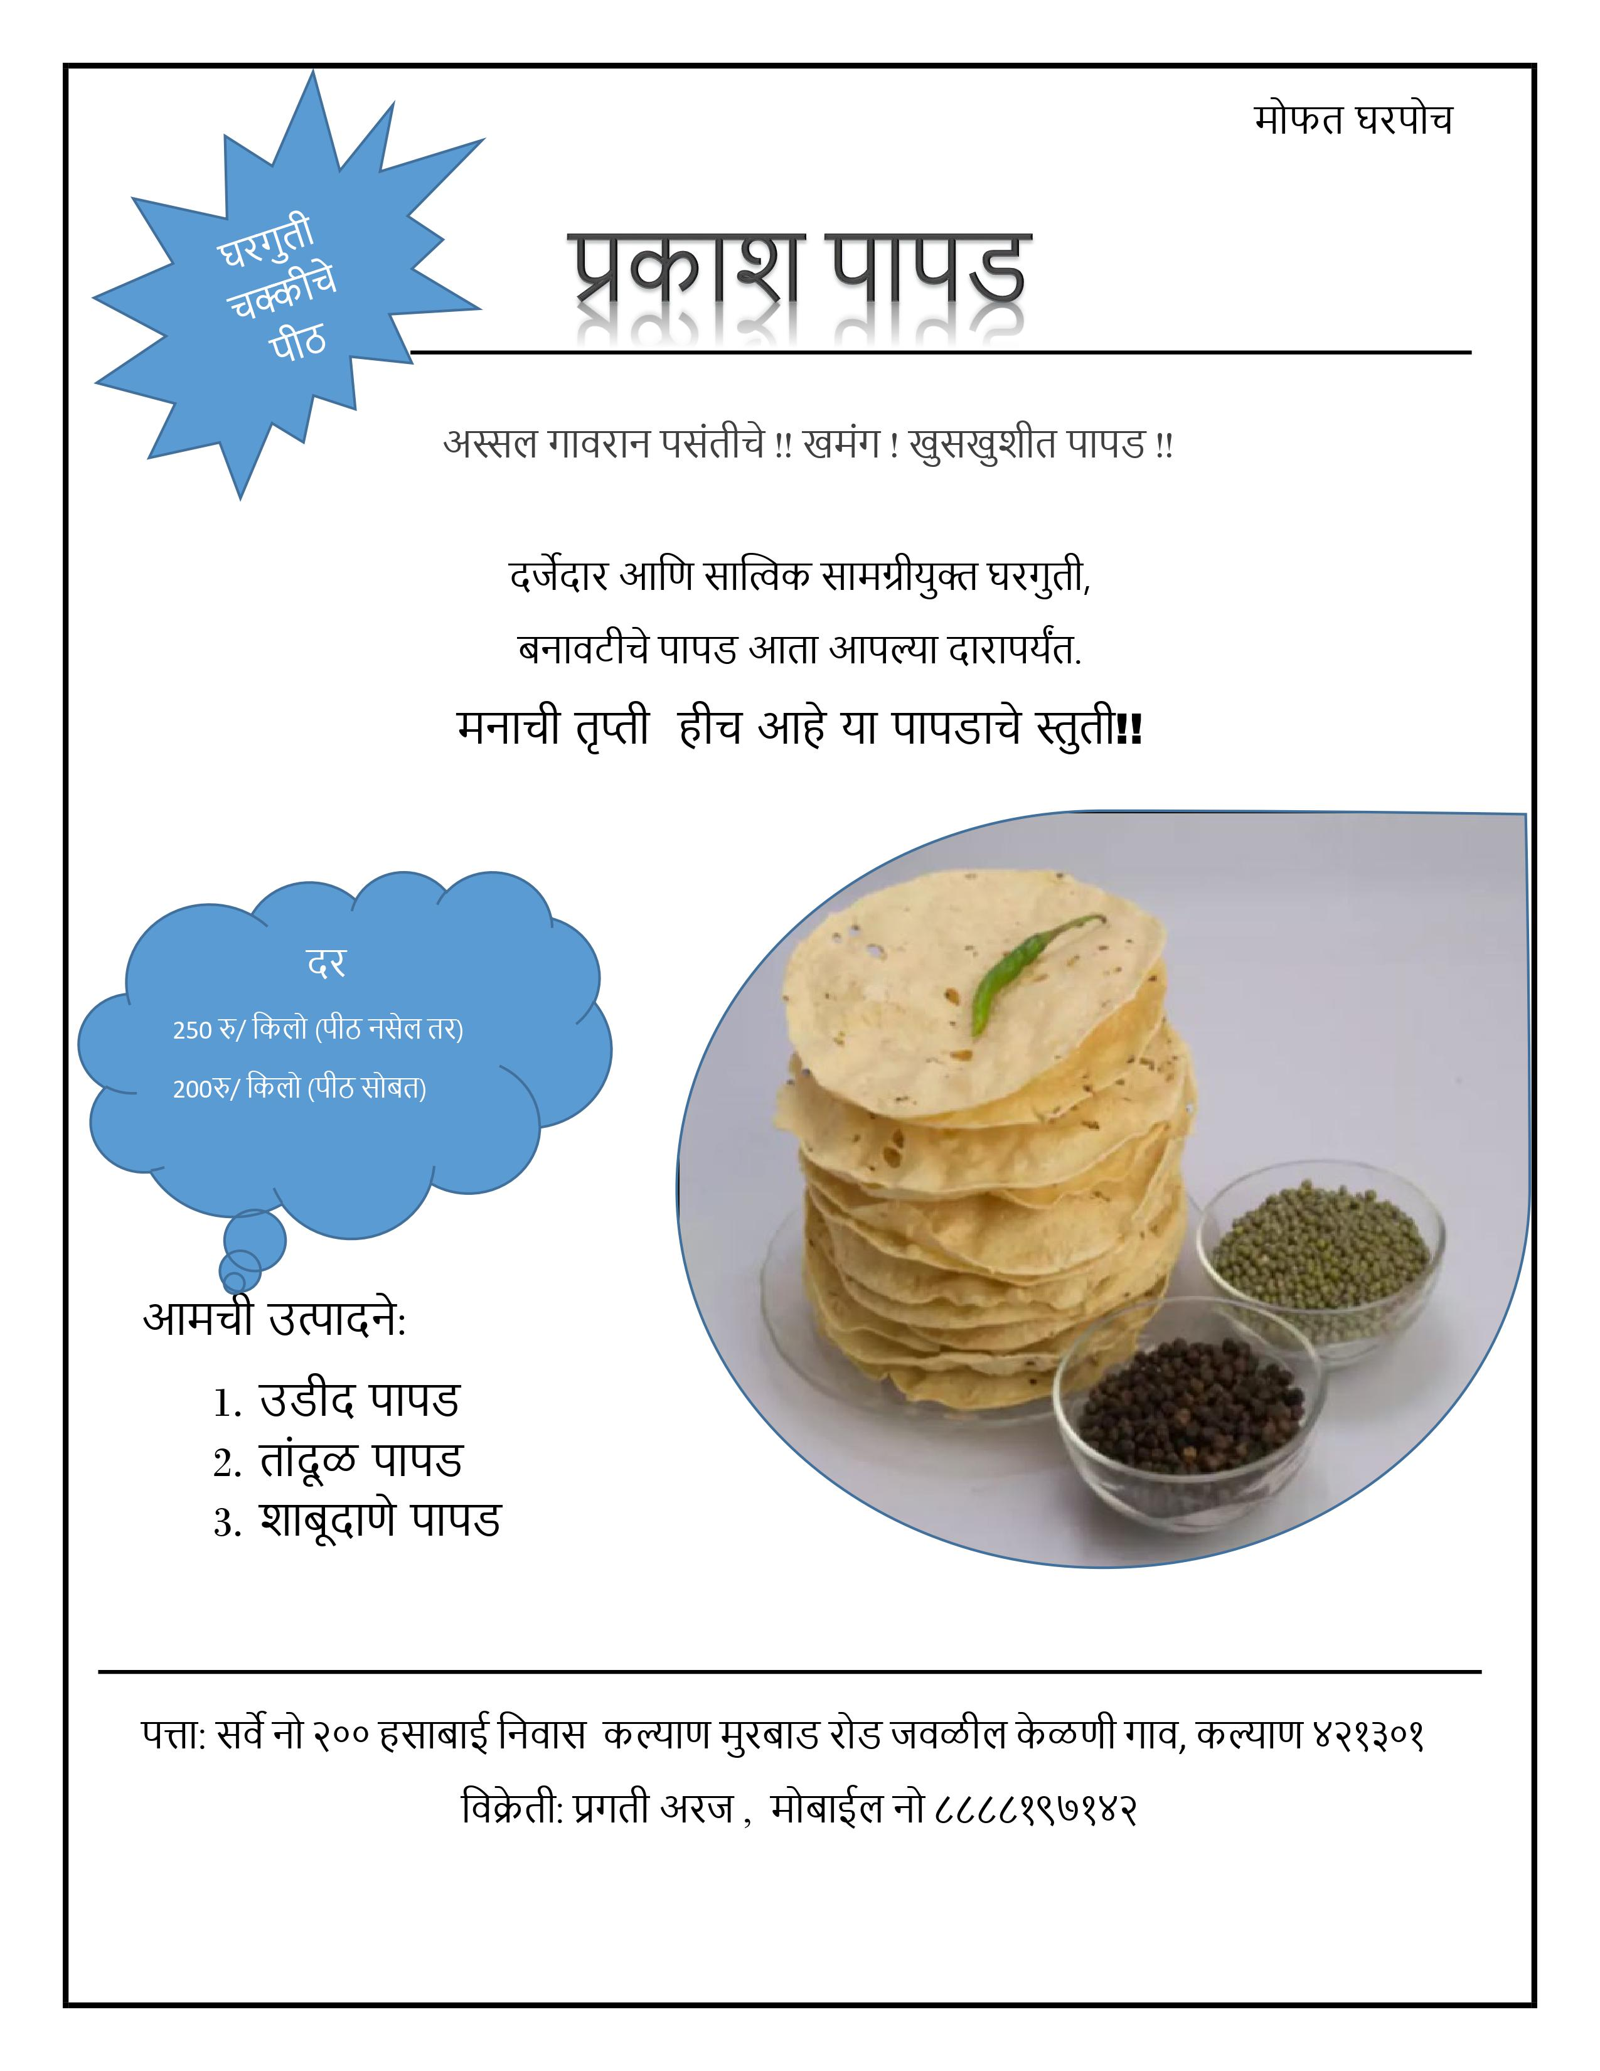
TEMPLETE FOR ADVERTISEMENT

Slide 11
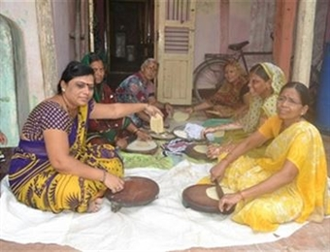
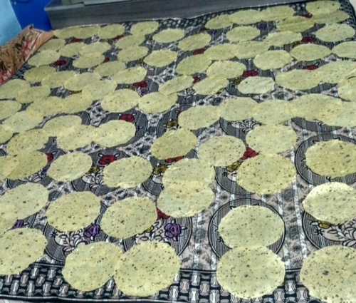
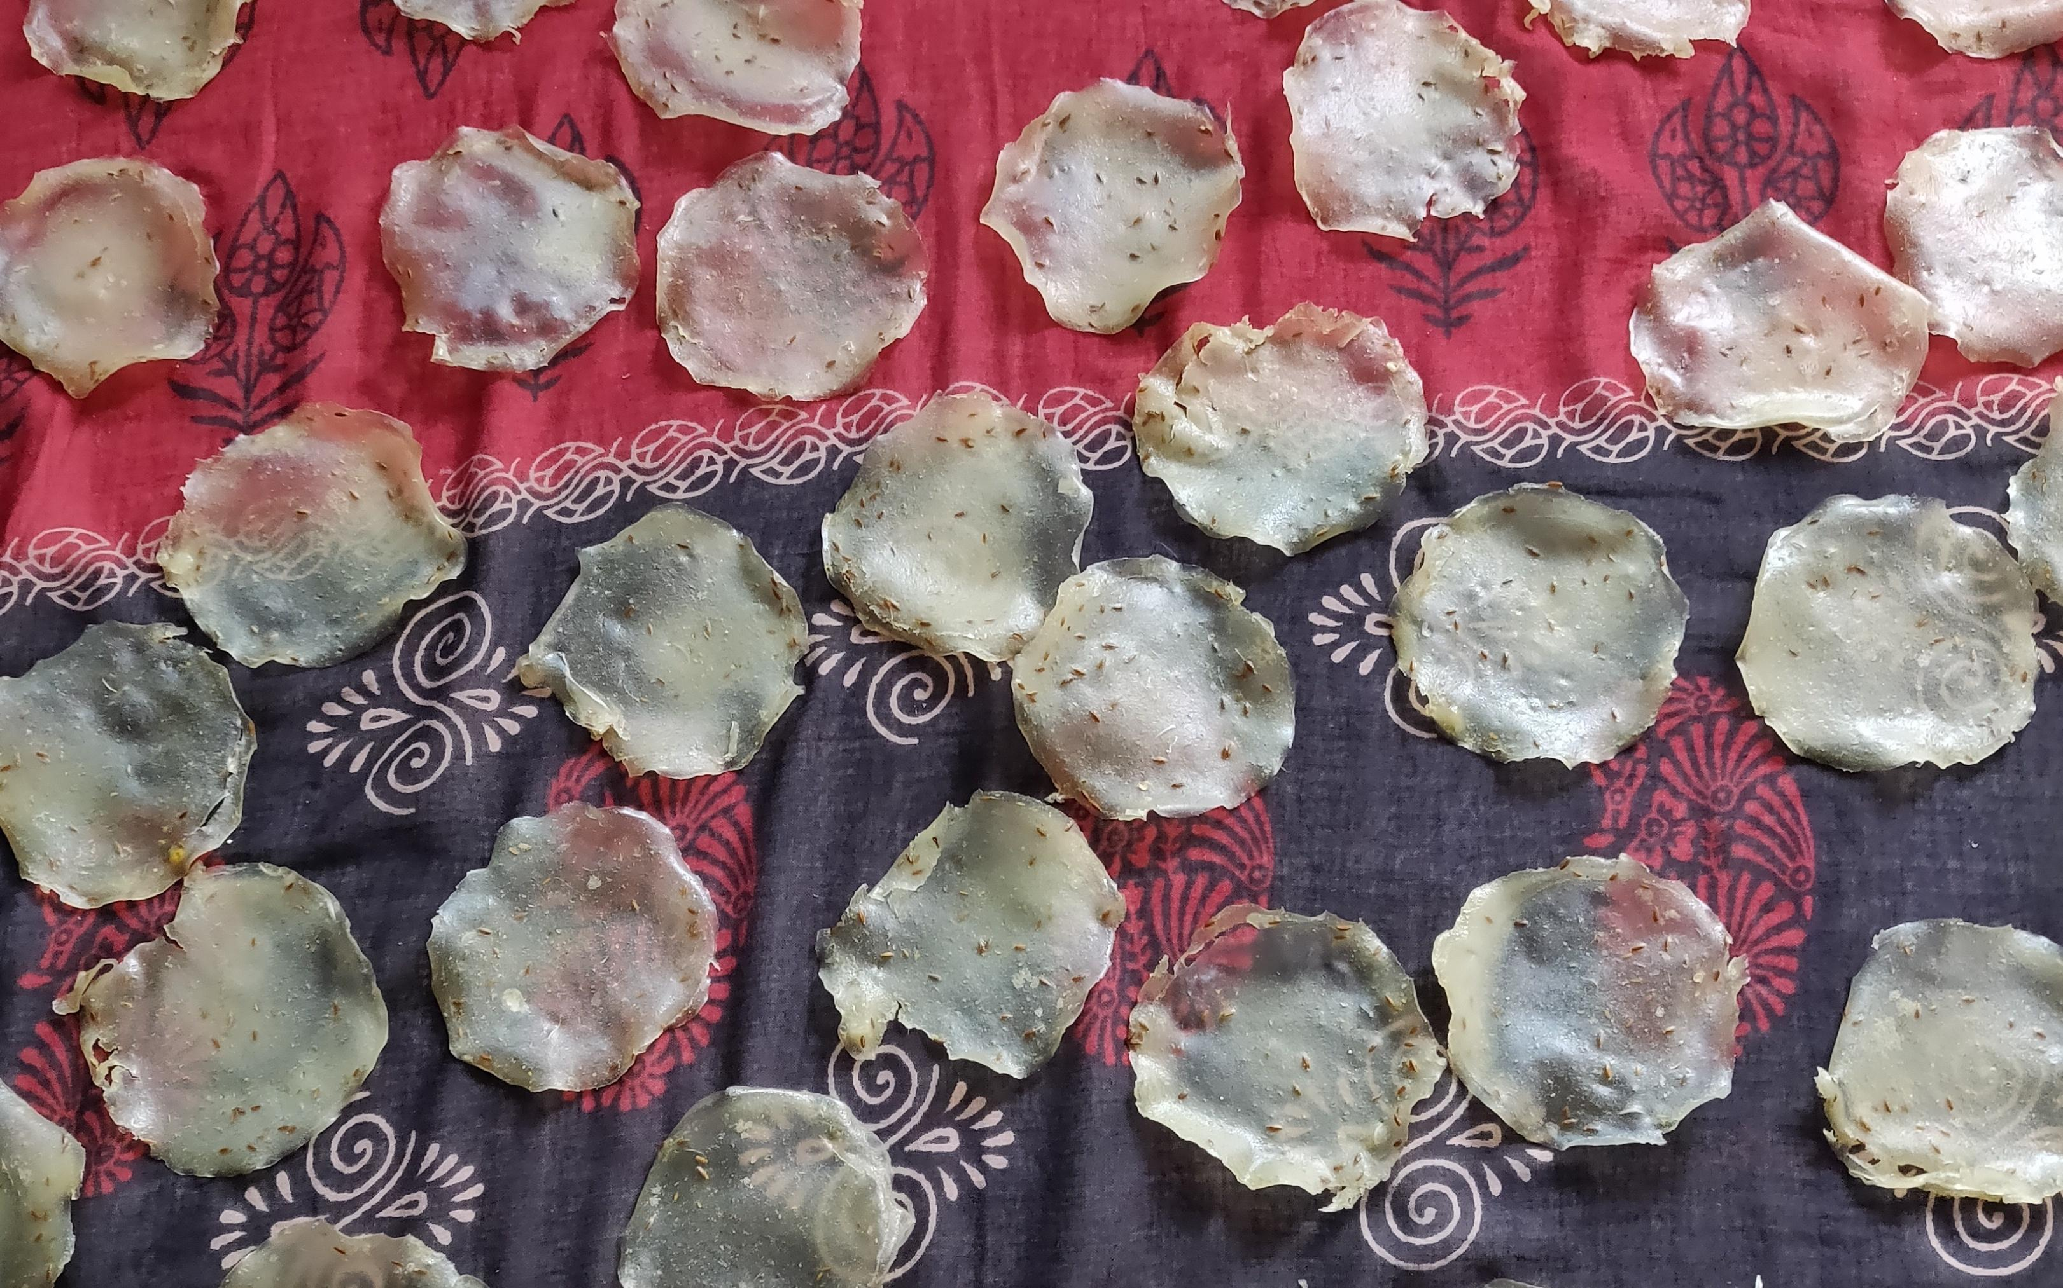
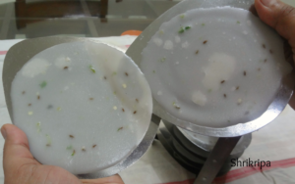

Slide 12
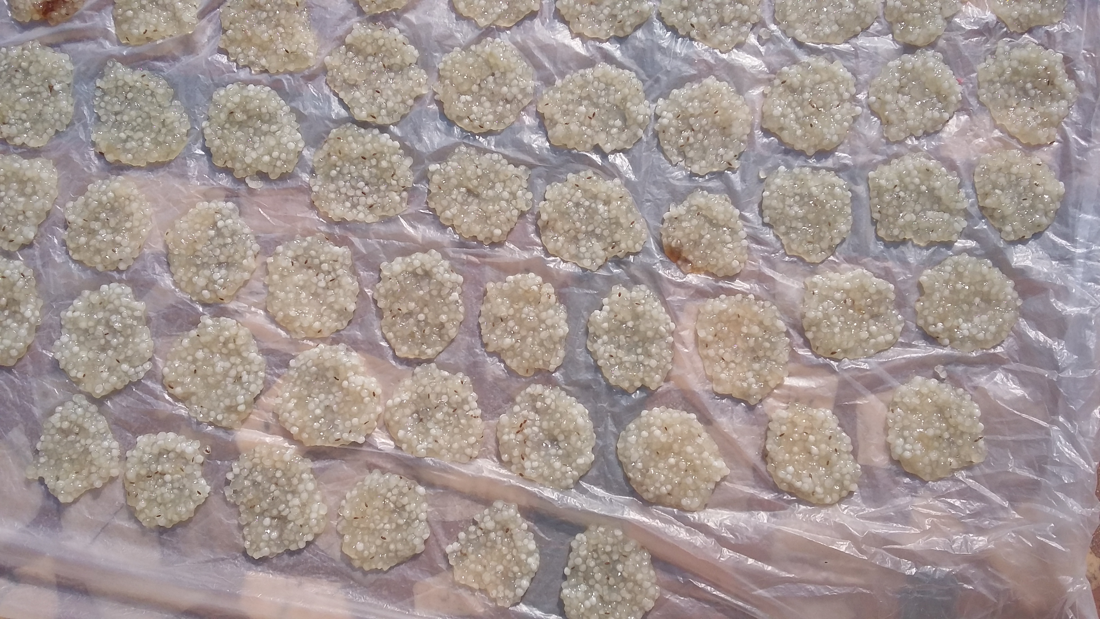
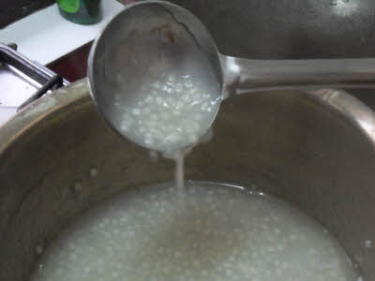
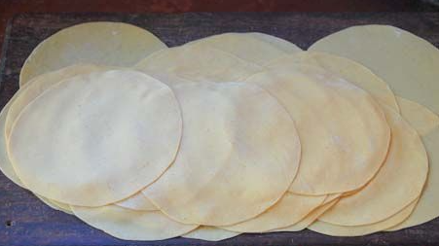
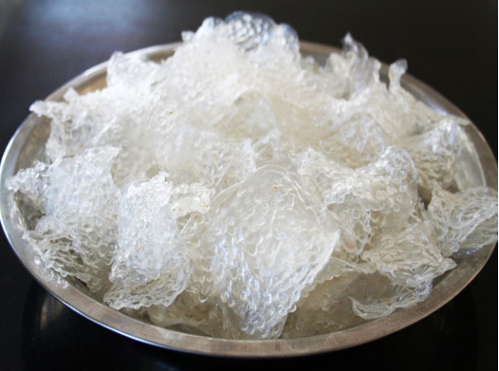

Slide 13

Thank You
CONTACT NUMBER: 8888197142

